Slide 1
Used Vehicles
Devangi Doshi
Harshala Doiphode
Heli Patel

Slide 2
Goal
There are many factors that influence buying and selling price of a car.
Depending on the model, mileage, fuel consumption, etc.

Slide 3
Motivation
Vehicle's potential resale value is an important factor while buying a car.
It is important to make an informed decision while purchasing a car.
There are various factors like standard color, mileage which affects the resale value of a car.
Reference : https://www.allstate.com/tr/car-insurance/consider-resale-when-buying-car.aspx

Slide 4
Dataset
Taken from Kaggle Used car dataset.
Collected from October 2018.
Update frequency : Quarterly
Latest update on April 2021

Slide 5
Attributes
439407 records, 25 columns
Numerical features:- Price, Year, Odometer, VIN
Location:- Longitude, Latitude, State, County,Region
Categorical:- Condition, Cylinders, Fuel Transmission, Drive, Title_status, Size, Type
Miscellaneous:- Url, Region_url, Manufacturer, Description, Paint_color

Slide 6
Data Visualization

Slide 7
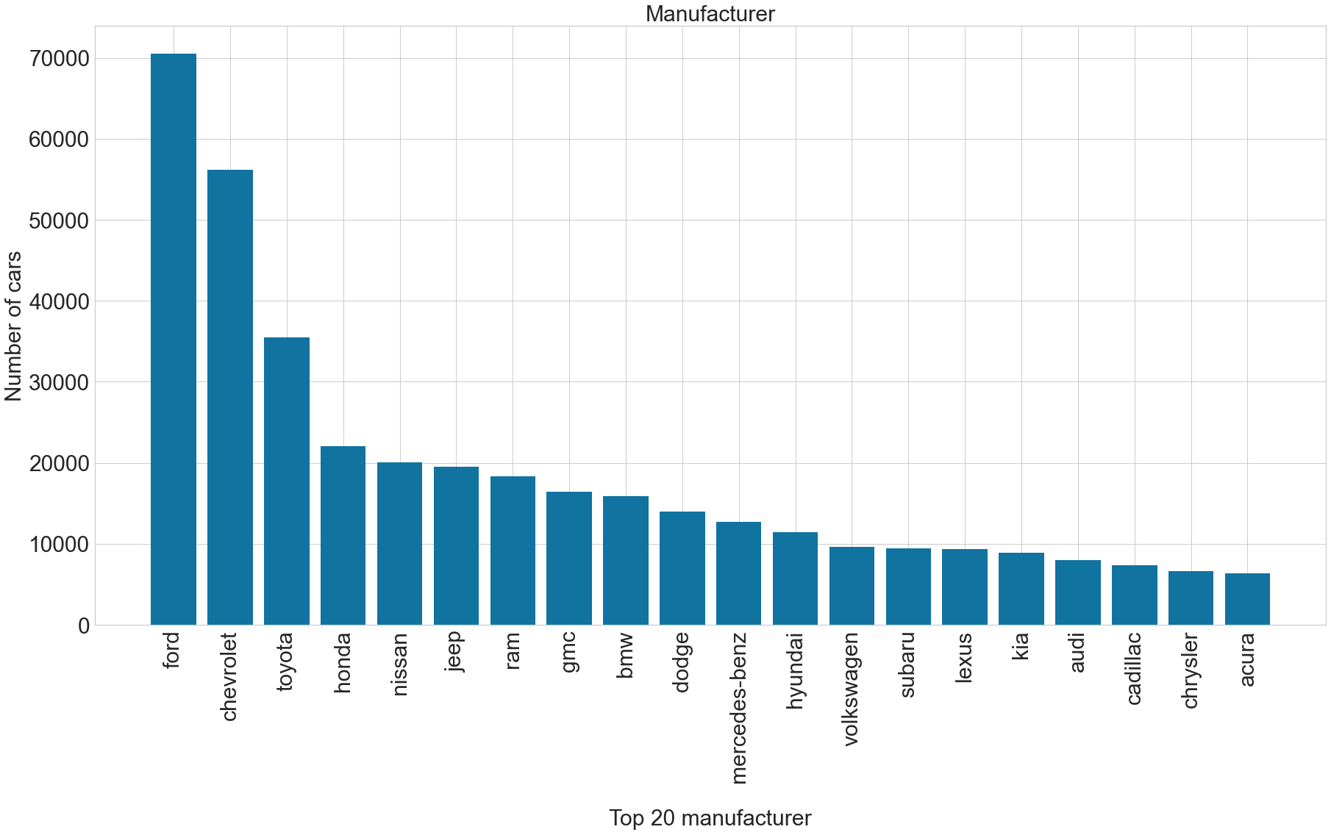
Number of Cars by Each Manufacturers
Ford cars are more listed for reselling as compare to other manufacturers

Slide 8
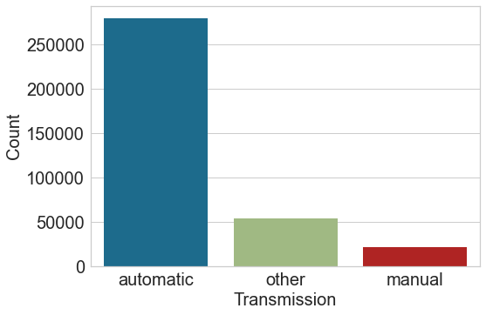
Transmission V/s Count
We can see that automatic cars are more preferred by the people rather than manual and electric cars

Slide 9
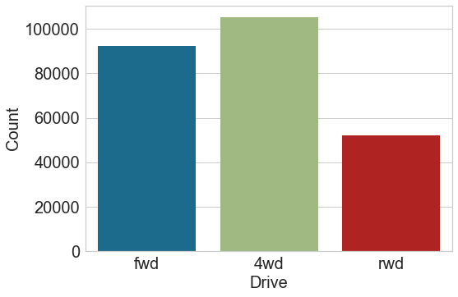
Drive V/s Count
4 wheel-drive drive cars are listed more for reselling

Slide 10
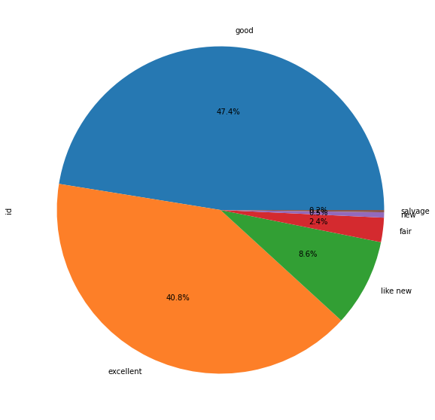
Distribution of Data by Condition
Good are more preferred for reselling

Slide 11
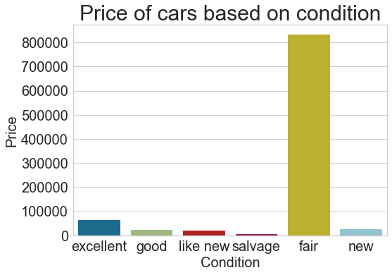
Price V/s Condition
Fair cars are more expensive.

Slide 12
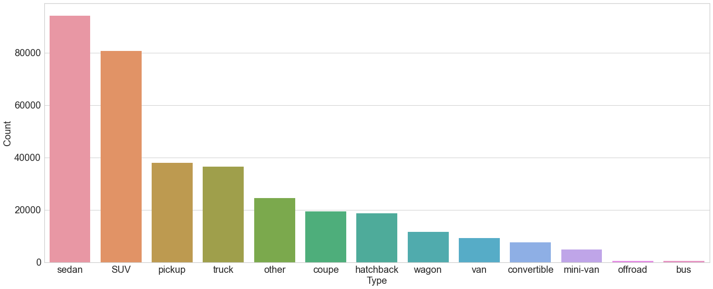
Distribution of Data by Car Type
Sedan cars are listed for reselling more as compared to other

Slide 13
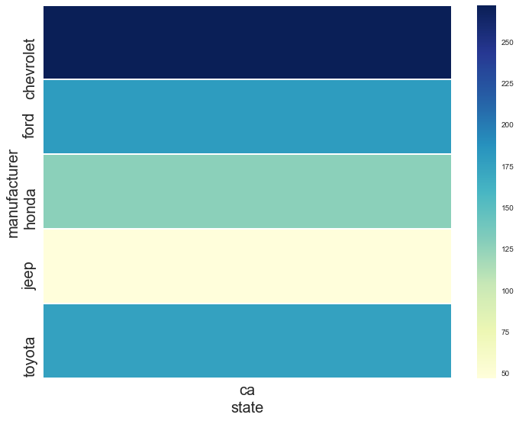
Distribution of Used Cars in California

Slide 14
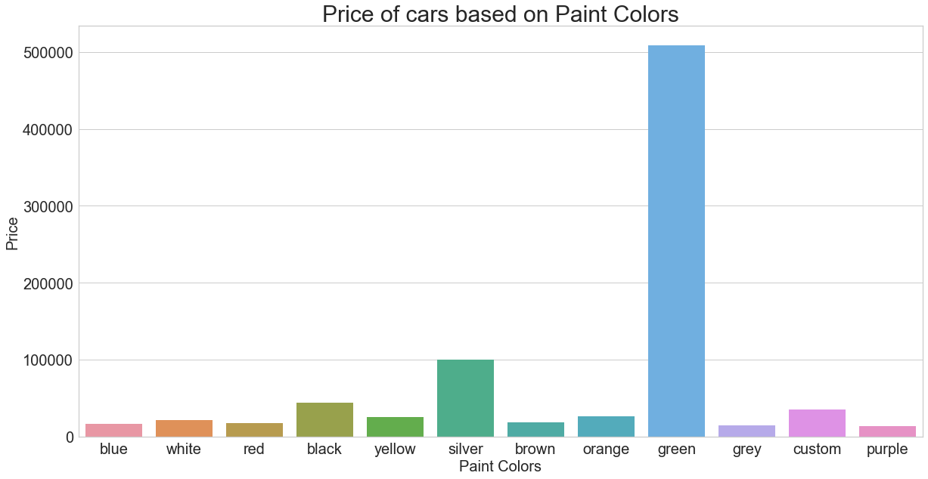
Prices of cars based on their colors
We can see that green color is quite costly.

Slide 15
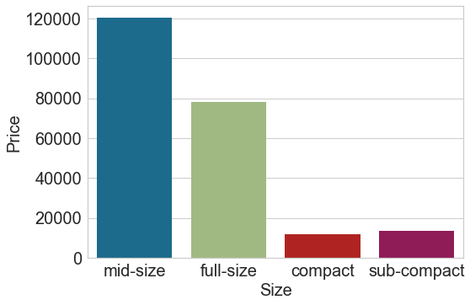
Prices of Cars based on their sizes
The mid-size cars are expensive

Slide 16
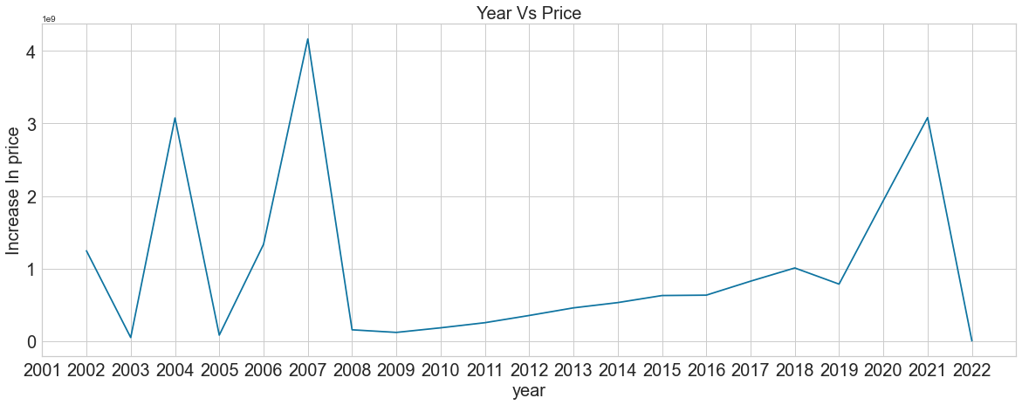
Change in prices of used cars over the years
Increase in price over year is changing unevenly. It was high in 2007 and than drop significantly.

Slide 17
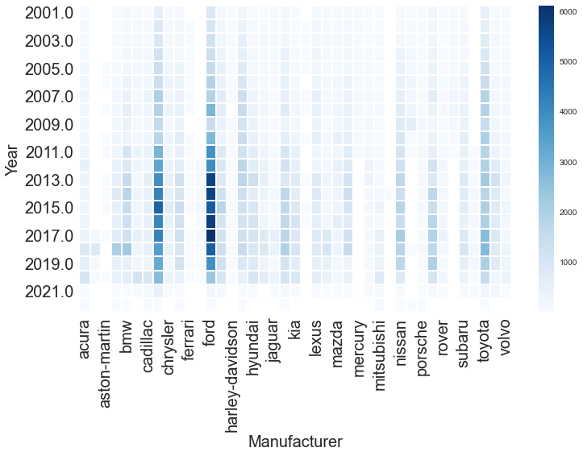
Manufacturer with most used cars for sale each year

Slide 18
Data Pre-Processing

Slide 19
Data Preprocessing
Handling Unwanted Columns:
'id', 'url', 'region_url', 'VIN', 'image_url', 'description', 'county','size', 'paint_color','model’
Dropping Duplicate Values

Slide 20
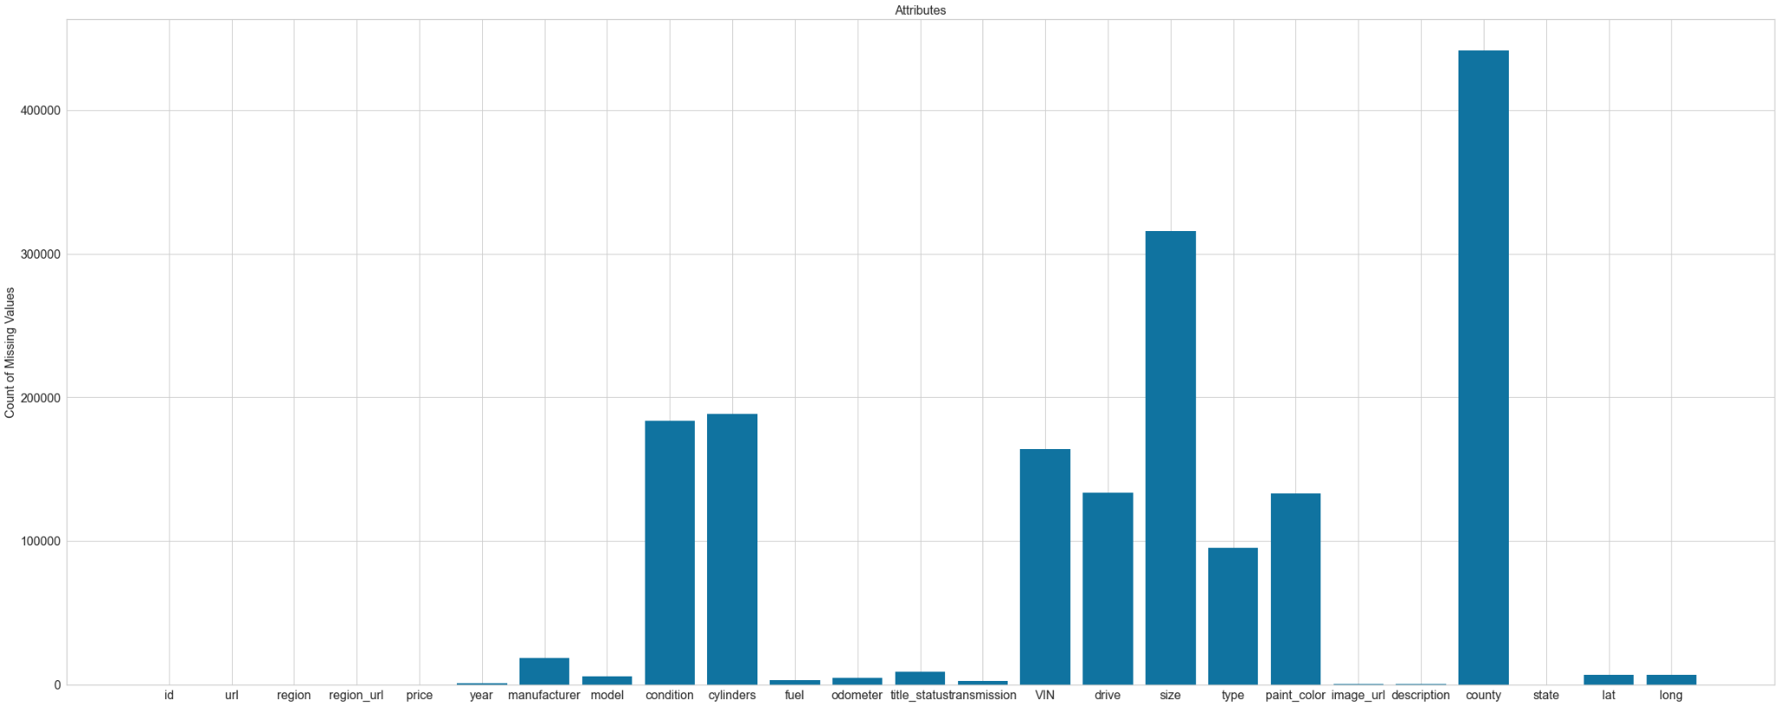
Missing Values in the Data

Slide 21
Handling null Values
Categorical Data: Using mode
Numerical Data : Using Mean
Categorical Encoding: LabelEncoder

Slide 22
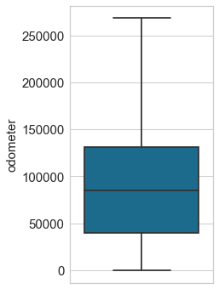
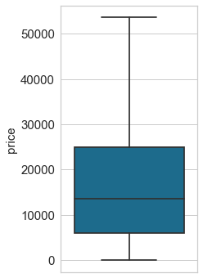
Handling Outlier

Slide 23
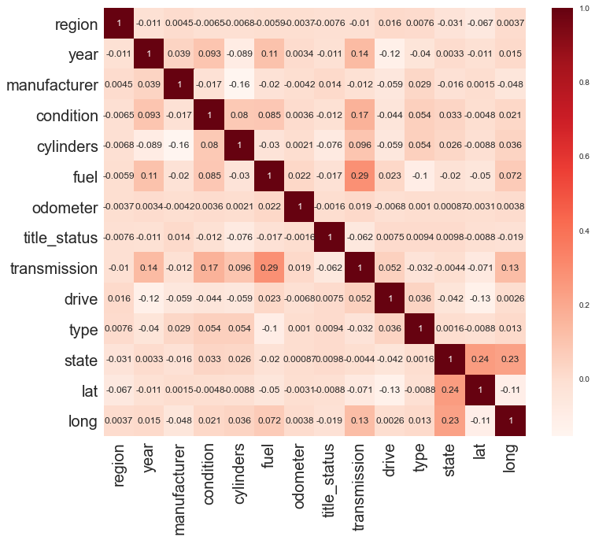
Correlation between features
From this correlation matrix, it can be seen that there is some positive correlation however, not that significant.

Slide 24
Model

Slide 25
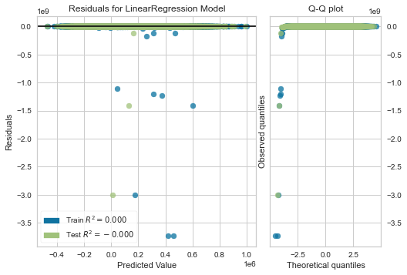
Regression Algorithms:
Linear Regression:
R2_score: -0.000203

Slide 26
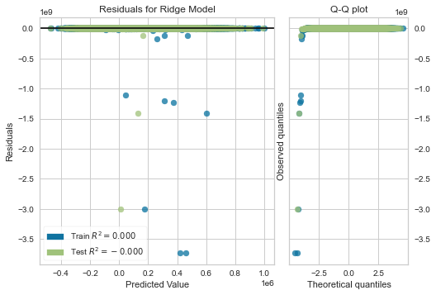
Ridge Regression:
R2_score: -0.000203

Slide 27

Lasso
R2_score: -0.000203

Slide 28
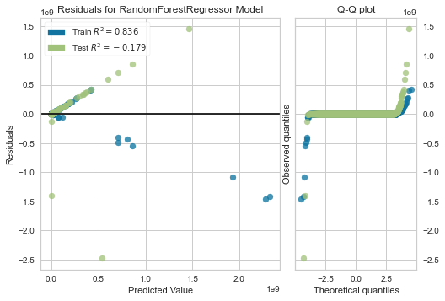
Random Forest Regressor
R2_score: -0.179028

Slide 29
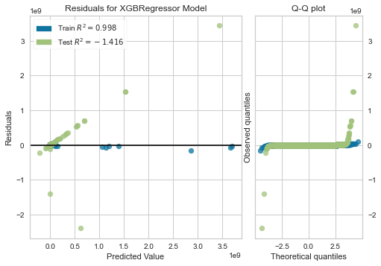
XGBRegressor
R2_score: -1.415707

Slide 30
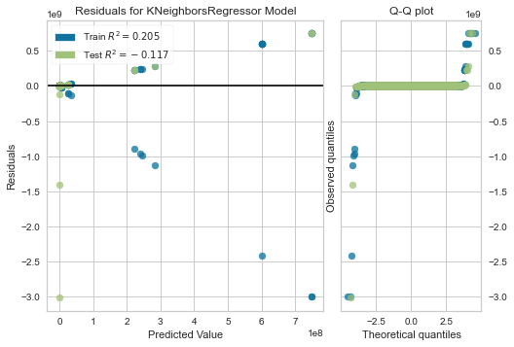
KNeighborsRegressor
R2_score: -0.117315

Slide 31
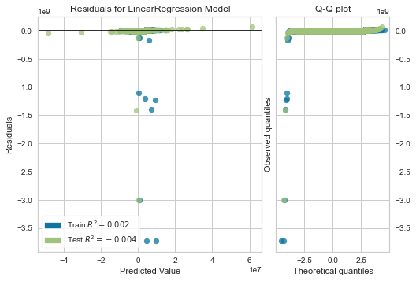
Polynomial Features ,
degree = 3,
Linear Regression
R2_score: -229.904998

Slide 32
Conclusion
Used various techniques to ensure our data is clean
We made decisions about dropping a column by analysing values in those columns
Focused on providing various charts and figures for better understanding
Implemented LinearRegression , Ridge Regression, XGB Regression, Lasso Regression, RandomForestRegressor, KNeighborsRegressor, Polynomial Transformation with Linear Regression

Slide 33
Thank you

